Slide 1




Create, connect and share respect:
A better internet starts with you!
Wellbeing and healthy relationships

Slide 2









How do you connect with your friends
and family online?

Slide 3
Who has ever…
Liked their friend’s comment?
Taken a selfie of you and your best friend?
Chatted in a group message?
Helped a friend in an online game?

Slide 4
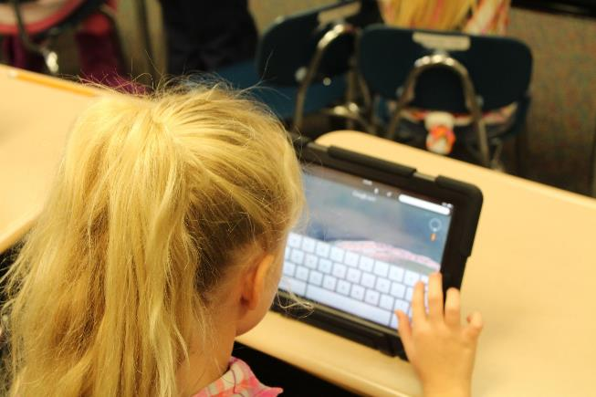
Think of the 3 friends or family you connect with the most online.
Why do you like spending time with them online?
Notes:
© SchoolPRPro licensed under CC0

Slide 5
Using video chat to talk to family who live far away
Playing with our school friends on online games at the weekend
Working together with our friends to get the top score on a game
The internet can give us lots of great opportunities to connect with our friends and family
Messaging our friends about a new band we think they would like
Sending our best friends a photo we took together

Slide 6





When you say or do things online that make others happy, how does it make you feel?
Notes:
Emoji provided free by EmojiOne

Slide 7





Unfortunately, sometimes when we’re online, we might see or receive things that are unkind or upsetting. How would these make you feel?
Notes:
Emoji provided free by EmojiOne

Slide 8



We all have different things that we are interested in, or make us laugh, and we all find different things upset us, or make us angry.
Notes:
Emoji provided free by EmojiOne

Slide 9
Sometimes when we are online it’s hard to tell what will upset someone and what will make them laugh.
When we communicate using the internet we can’t be sure if other people will always understand what we mean, because…
We can’t always use body language or facial expressions.
In a message you can’t always express your tone of voice
We might find something funny, but someone else finds is mean

Slide 10
You will now see 5 different ways people behaved online.
Decide how you feel about each one using these actions:
Hands in the air:
Great! A really kind thing to do
Hands on your shoulders:
I’m not sure this is okay
Arms crossed:
This isn’t a kind way to behave online

Slide 11
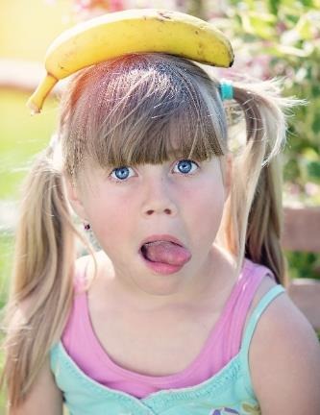
1. Mikala takes a really silly photo of Abi. Later on, Mikala shares it with some other
friends without checking with Abi.
Hands in the air: Great! A really kind thing to do
Hands on your shoulders: I’m not sure this is okay
Arms crossed: This isn’t a kind way to behave online
© Pezibear licensed under CC0
Notes:
© Pezibear licensed under CC0

Slide 12
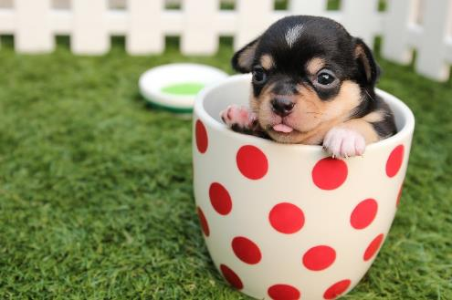
2. Josh sees Kerry upset at school. He knows her favourite animals are dogs, so later on he finds a funny video of some puppies and sends it to Kerry.
Hands in the air: Great! A really kind thing to do
Hands on your shoulders: I’m not sure this is okay
Arms crossed: This isn’t a kind way to behave online
© Teerasuwat licensed under CC0
Notes:
© Teerasuwat licensed under CC0

Slide 13
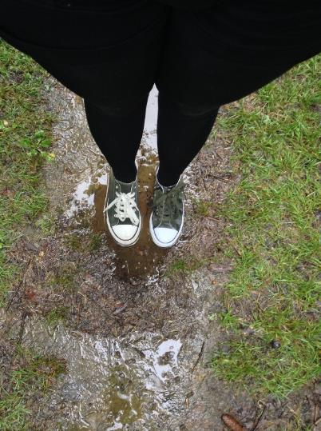
3. Afua falls in the mud in the park.
Her brother films her falling over, and
sends it to her because he thinks
she’ll find it funny too.
Hands in the air: Great! A really kind thing to do
Hands on your shoulders: I’m not sure this is okay
Arms crossed: This isn’t a kind way to behave online
© Bunzellisa licensed under CC0
Notes:
© Bunzellisa licensed under CC0

Slide 14

4. Martha logs in to her favourite game that she plays with her friends from school. She makes a mistake and loses all the
points they had won yesterday. Her
friends get angry, and make her leave
the game.
Hands in the air: Great! A really kind thing to do
Hands on your shoulders: I’m not sure this is okay
Arms crossed: This isn’t a kind way to behave online
© Clkr-Free-Vector-Images
licensed under CC0
Notes:
© Clkr-Free-Vector-Images licensed under CC0

Slide 15

5. Siddiq gets a new haircut.
After school he gets a message from someone saying that they don’t like it.
A couple of other people see this, and
start saying other upsetting things to him.
Hands in the air: Great! A really kind thing to do
Hands on your shoulders: I’m not sure this is okay
Arms crossed: This isn’t a kind way to behave online
© OpenClipart-Vectors licensed under CC0
Notes:
© OpenClipart-Vectors licensed under CC0

Slide 16
Different people will find
different things upsetting,
mean, funny or interesting.
However, in general we all need the same key
ingredients from our friends and family to be
happy online.

Slide 17



What are the key ingredients we need to feel happy and good about ourselves online?
Helping
our friends online
Knowing what to do if something goes wrong
Sharing things with other to cheer them up or make them laugh
Taking regular breaks from the internet
Checking with others before about the things we share
Making positive
choices online
Notes:
Emoji provided free by EmojiOne
© Clkr-Free-Vector-Images licensed under CC0

Slide 18
Why does it matter what I share online?

Slide 19
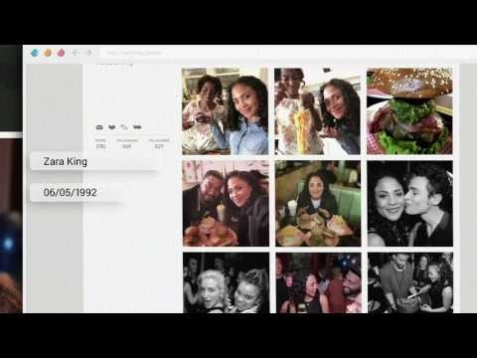

Slide 20
How old do you have to be for:
Facebook?
Snapchat?
YouTube?
Whatsapp?

Slide 21
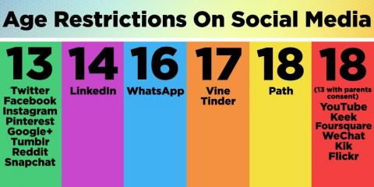

Slide 22
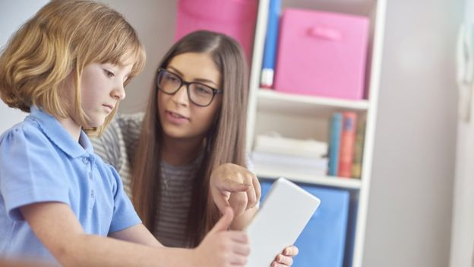
What are terms and conditions?
Why are they there?
http://www.bbc.co.uk/newsround/38992576
Speak to an adult you trust if you are not sure about anything

Slide 23
http://www.bbc.co.uk/newsround/13910067

