Slide 1

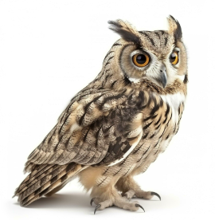
Class Essentials
Owl Class
Mr Pastor
September 2026

Slide 2
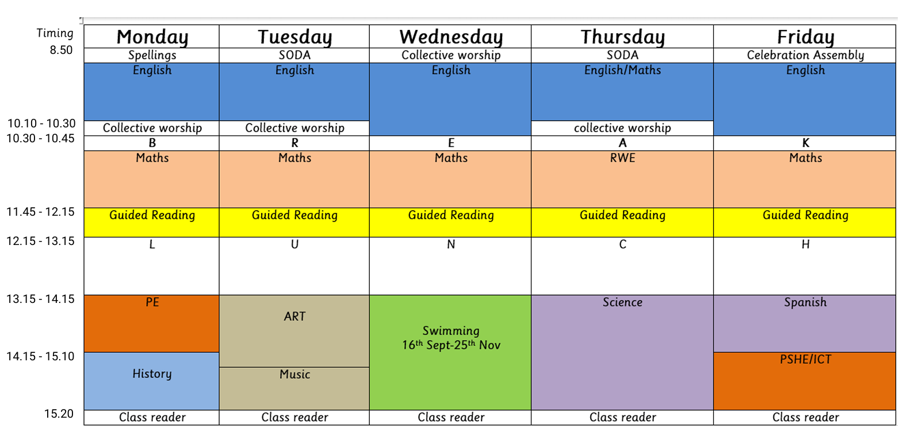
Typical day and week
Notes:
Music teacher -same as last year

Slide 3
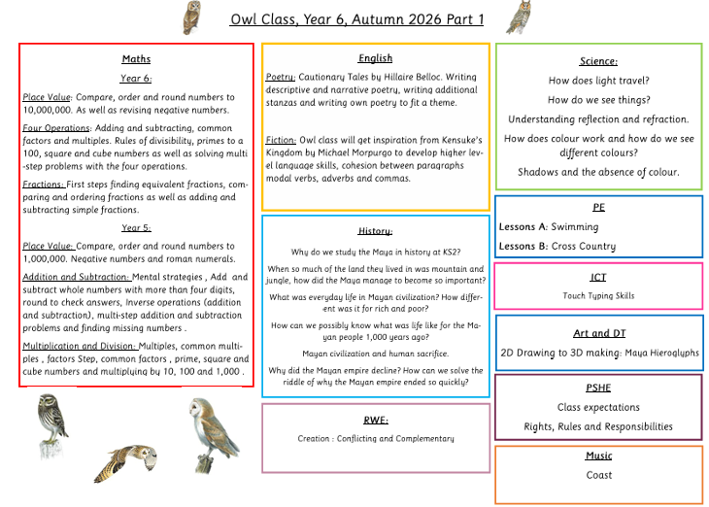
Curriculum
Our class reader for this half term is Kensuke’s Kingdom By Michael Morpurgo
The curriculum outline is on the school website.

Slide 4
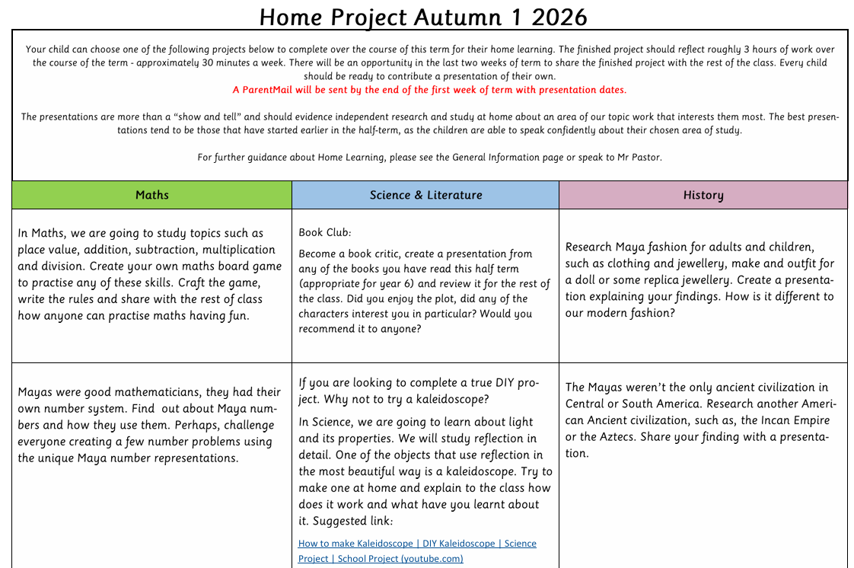
Home Learning Resources
Home Learning Projects - these are a great opportunity for speaking and listening, confidence building, sharing ideas, developing new skills, chance to be creative and independent. Please do try to make the home learning as independent as possible.
T
Notes:
HT - mention home learning project and times tables rockstars.

Slide 5

Website
Please do see the website for any general information about the class.
There are lots of usual resources to help support your child in things such as reading, SPAG and maths.
The gallery will also be in use with pictures of different activities that have occurred throughout the year.

Slide 6
What to bring and what to leave at home
Please clearly label everything with your child’s name.
A healthy snack for play time: fruit or vegetables. (Sesame allergy)
Water bottle; named and separate from lunch box.
Wear PE kits to school on PE days (Mondays and Wednesdays) Hair tight up and no hoop earrings.
Pencil cases are no necessary – learning pack system.
Please don’t bring in:
Toys from home.
Unnamed items of clothing (winter - gloves and hats).
Sweets or cakes for children’s birthdays.
Notes:
Really keen on having books on tables that they can just pick up when there is a couple of free minutes.
Reading record, they are allowed to write in it and might be worth them writing a few lines to show they have understood the book when they have finished writing it.
Musical instruments can go home.
Worth mentioning about booking on for school dinners because still some haven’t.

Slide 7
How can I help at home?
Make sure your child is ready for school - uniform (Come in PE Kit on PE days-Mondays and Wednesdays), sleep, snack, healthy lunch, (
Do promote coming to school as a good thing!
Reading every day - either listen to your child read or share a book or read alongside each other.
Check the website regularly.
Practice spellings
Start the home learning project with plenty of time - practising time organisation for later independence.
Notes:
LCWC - look, cover, write, check sheet will be given out on friday

Slide 8
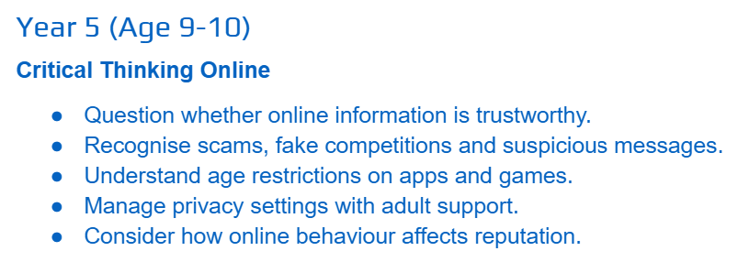
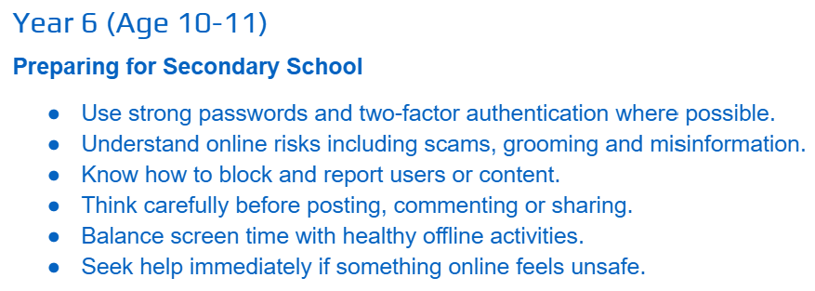
Behaviour and safety
Expectations must be high for learning and behaviour.
Barton Bs and promotion of school values.
E-safety and its importance in UPKS2.
Notes:
emphasis that it has been simplified a bit this year.
Esafety is very important we are covering this in computing. There probably will be a parents session for this but the date hasn’t been set.
If there is an incident parents will be contacted that day - perpetrator and victim

Slide 9
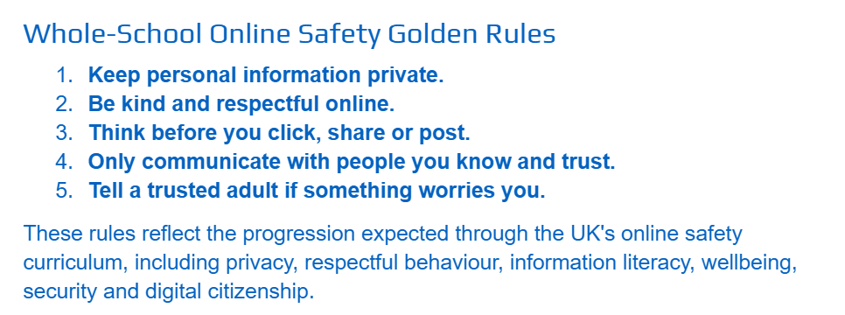

Slide 10
Communication - home/school
On the day brief messages: To teachers on the gates face to face at 8.45/3.20.
Changes to admin information: email office e.g. changes of address, who is picking up.
Surprises/emergencies: email directly to the office.
Injury: accident slips please check bags regularly.
Parents to drop off and collect from the pedestrian gate on New Road 8.40-8.50am and 3.20-3.25pm. Please only enter the building via an appointment at the School Office. No games on the playground before the start of the day.
Please book up an appointment if there is a more lengthy issue in person or by email. Email address on class page of the website.
Notes:
Whatsapp group, please keep it positive and inclusive. Any issues raised please speak to teachers.

Slide 11
Parents involved in school
We want to work in partnership with you and your family.
There are many ways you can contribute to an enriched educational experience for all the children:
Things you can be involved in:
FOBS
Sharing your expertise e.g. chess? Art? - on a regular or adhoc basis,
Volunteer helper are fantastic, please get in touch if you are interested.
Notes:
Very happy for parents to come in and read with their child - need to work out when would be a good day for this.
FOBS - Friends of Barton School
Specific skill.

Slide 12
Other information:
RSE coverage in the Spring term
SATs are usually held in May:
Starting Monday 10 May and ending Thursday 13 May 2027.
Notes:
Worth mentioning there will be a SATs evening later on in the spring term.

Slide 13
Other Information
A residential trip to Grafham Water Centre is booked - dates:
Monday14th – Wednesday 16th June 2027.
We will provide more information later on in the year.

Slide 14

Any questions?

