Slide 1

Class Essentials
Kingfisher Class
September 2026
Mr. Burn
Notes:
Welcome to Kingfisher Class. Thank you for making the time to come here this evening and I hope you will find the session informative. There will be a chance for questions at the end. If these questions could be general about the class organisation rather than specific to your child I would be very grateful. I will share with you in a moment the best ways to make appointments to discuss worries or concerns pertinent to individuals. We will also have a parents consultation opportunity nearer half term

Slide 2

Website www.bartonprimary.org.uk/page/?title=Kingfisher+Y2&pid=58
Notes:
Please look on for the school website for any information and your child’s learning or general things that are happening in school.

Slide 3
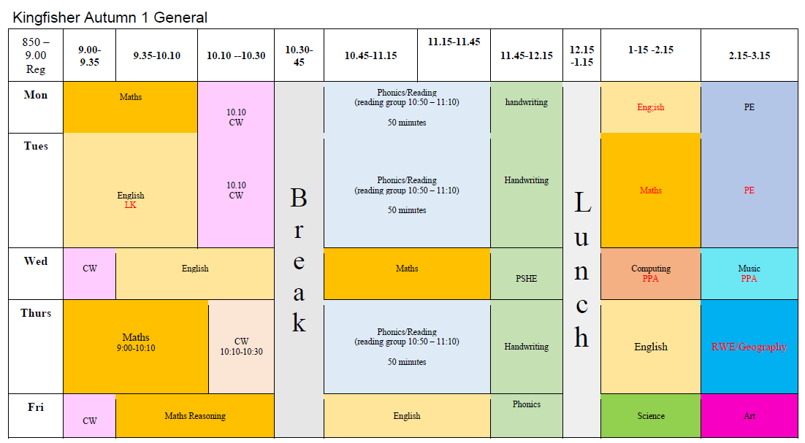
Typical day and week
Mr Burn teaches all week apart from Wednesday afternoons when Mrs McNeil will be covering the class.
The children are supported by:
Mrs Kim until lunch Monday-Thursday
Mrs McNeil Wednesday after lunch
Notes:
A typical timetable can be found on the school website and this is what timetable will look like in the coming weeks when we are more settled with the classroom structure. I will teach every day except for Wednesday afternoons when Mrs McNeil will be teaching. She is a very experienced TA who most of you probably know and is already very familiar with the children.

Slide 4
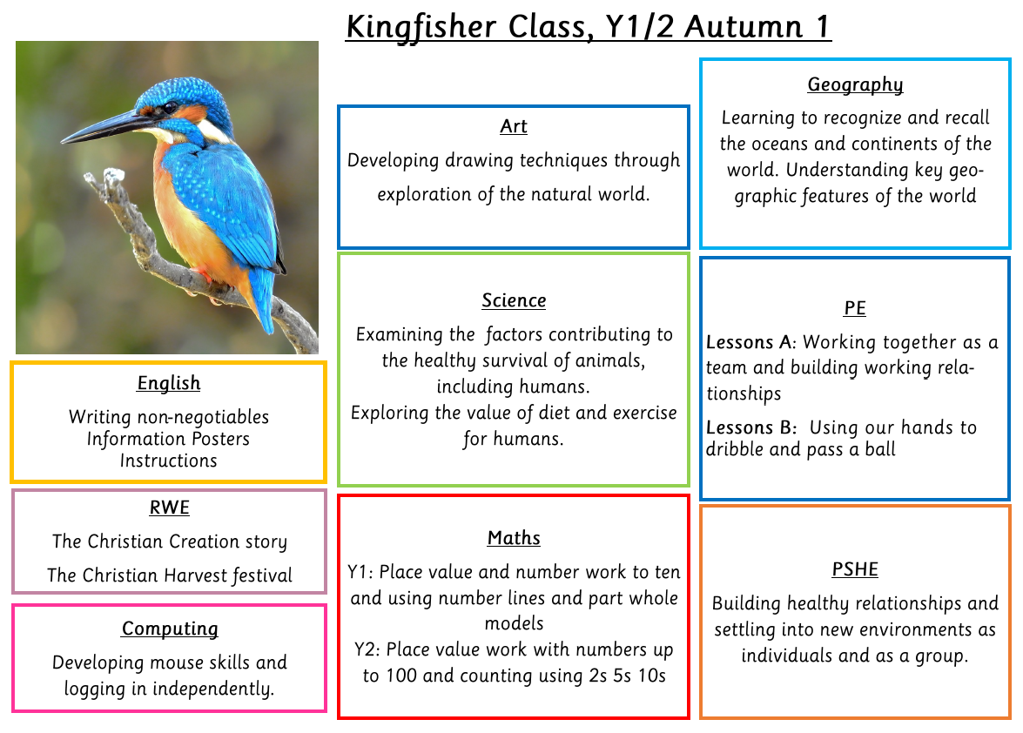
Curriculum
Our progression documents can be found on the school website and show the skills and subject content that will be covered for each year group in more detail

Slide 5
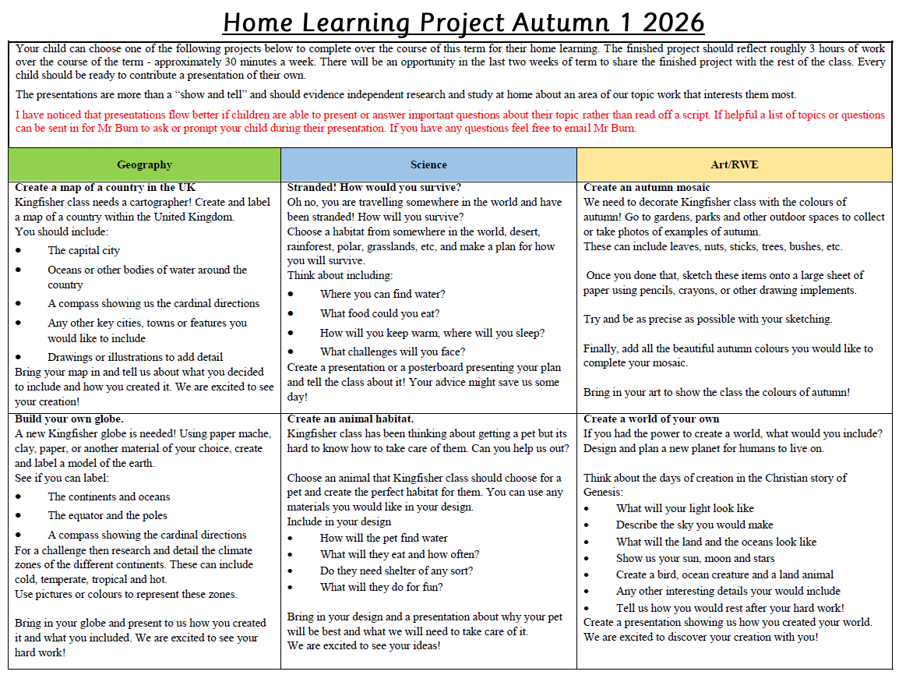
How you can help at home
Home Learning projects: how this will work and expectations
Notes:
There is a copy of this home learning on the web site in the Home Learning Section and I shall send one home with your children. The expectations are written at the top. Summarise. Explain how you will organise the days for presentation. (when will presentations happen?)

Slide 6
How you can help at home
Reading every day - either listen to your child read or share a book or be interested in your child’s reading. Let them see you reading - you are the best role model.
Encouraging them in their learning - asking them questions about their lessons.
Finding out about the topics they are learning about - do you have any resources or knowledge you could share?
Practise spellings - have the Common Exception Word Sheet somewhere visible e.g. kitchen fridge
Thank you all so far - your children have all been so well prepared for the school day and so positive!
Notes:
Discuss Little Wandle vocab sheets
Reading good for writing, comprehension, and enjoyment. We will start sending home weekly spellings to practice next week and we will have a weekly quiz every Monday to see what areas we need to work on.

Slide 7

Notes:
Mention Little Wandle - how they are selected

Slide 8

Notes:
Our little Wandle program starts next week but I have sent home reading records today so we can get back into the swing of using them. If you do any reading with your child at home it would be lovely to see an entry in the reading record to have an idea about how much the students are reading at home!

Slide 9
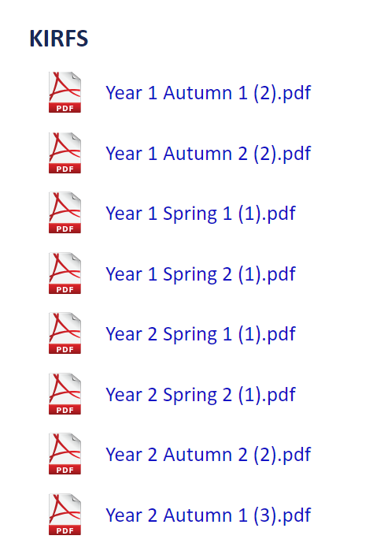
Maths
On the website in the Home Learning Section click on Maths Support. Under KIRFS there are Home learning packs for each half term.
In Autumn we will be recap on number recognition, writing, and formation. This can be extended by counting up to 100 both forwards and backwards.
We will then extend our focus on number bonds to 20 alongside our work on number bonds
Notes:
Keeping Y1 KIRFS up in case you want to do extra practice or review.

Slide 10

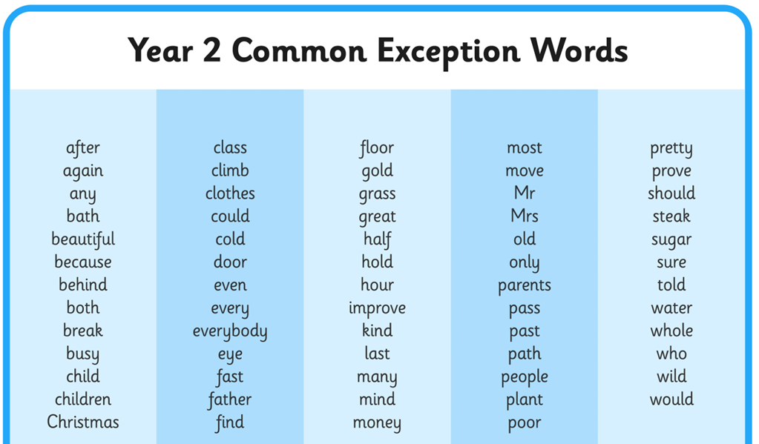
Spelling
Year 1 and Year 2 pupils are expected to spell most common exception words correctly by the end of the year.
Having these words up on a fridge and practicing spelling them is an excellent way to help them to this target.

Slide 11
What to bring and what to leave at home
Please clearly label everything with your child’s name.
A healthy snack for play time: fruit or vegetables
Water bottle; named and separate from lunch box.
Wear PE kits to school on PE days (Monday and Tuesday).
Reading books and Reading Journals everyday.
Please don’t bring in:
Toys from home.
Unnamed items of clothing (winter - gloves and hats).
Big rucksacks – as it gets colder we will need space for coats.
Sesame seeds
Notes:
Also nuts as we have chn with nut allergies in school and in class.

Slide 12
PE kits
White t-shirt
Black or navy shorts/joggers (weather dependant)
School sweatshirt and/or fleece
Long hair tied back
Earrings removed, or covered if not possible.
Suitable trainers.
Children should not wear football kits, non-school uniform, or other ‘fashionable items.

Slide 13
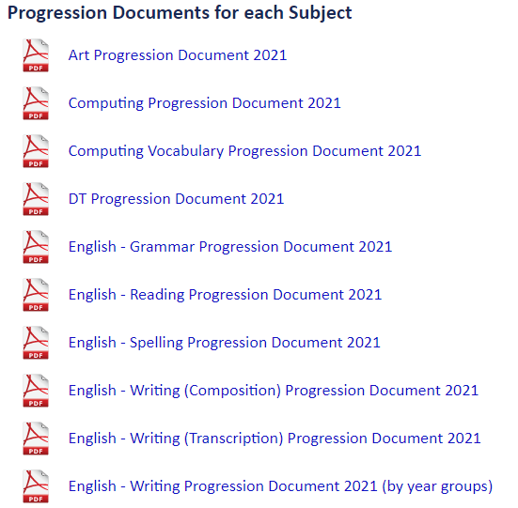
What will my child be learning?
https://www.bartonprimary.org.uk/curriculum-subjects/
Here you can find progression documents breaking down each curriculum subject into year groups and objectives.
Alongside the half-termly overview on the class webpage, this will summarise the key areas of learning for each year group, and break these down into smaller statements.
Notes:
On under curriculum.

Slide 14
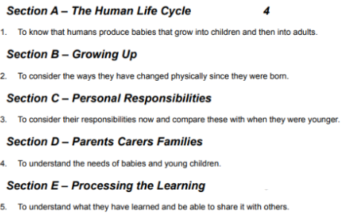
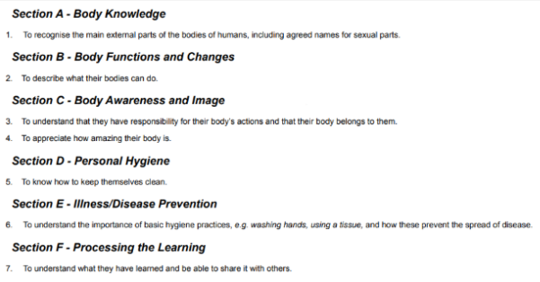
RSE
Year 1 Year 2

Slide 15
Online saftey
Year 1 (Age 5-6)
Staying Safe Online
I only visit websites my teacher or parent approves.
I never share my name, address or school online.
I tell an adult if I see something that worries me.
I use kind words online.
I understand that not everyone online is who they say they are.
Year 2 (Age 6-7)
Being Responsible Online
Keep passwords secret from friends.
Ask permission before downloading or clicking links.
Think before sharing photos.
Treat others with respect online.
Tell an adult about unkind messages.

Slide 16
Behaviour and safety
We expect a high standard of behaviour at all times.
3 Barton Bs.
If there any incidents where your child is hurt or another child is hurt, then you will be informed by the end of the day.
E-safety is very important - training in school and resources on the website
Parents to drop off at the playground and collect from classroom door.
Notes:
Be safe, Be Respectful, Be Learners. Kind.. Think.

Slide 17
Communication - home/school
On the day brief messages: To class teacher in the playground in the morning. Face to face at the end of the day.
Changes to admin information: email office e.g. changes of address, who is picking up
Surprises/emergencies: email directly to the office
Please book up an appointment if there is a more lengthy issue in person or by email.
Notes:
Nice if we know anything to celebrate, or anything that might be worrying your child that day etc

Slide 18
Parents involved in school
We are a partnership with you and your child.
We want your child to achieve the best they can and to have the most positive educational experience.
Things you can be involved in:
FOBS
Sharing your expertise e.g. Topic? Art? - on a regular or adhoc basis,
Volunteer helper
Volunteering for trips and activites
Amazon WISHLIST: one per class plus other special events such as writing weeks. Our first writing week in November has a wishlist attached to it, which can be found on last week’s bulletin

Slide 19

Any questions?

