Slide 1
E-Safety Talk
Katie Slusar-Fletcher
Computing link governor at Barton
Assistant principal attached to year 7 for Comberton Village College

Slide 2
Spending time online…
59%
3/4
of children say the internet has a positive impact on their wellbeing*
of children say the internet/tech is important for their independence**
% of children who say spending time online makes them feel confident**
*Internet Matters tracker survey, Wave 19 (2024)
**Children’s Wellbeing in a Digital World, Year Three, Internet Matters (2024)
The data in these slides is based on a survey of 9 to 17 years olds by the organisation Internet Matters, children self-reported the data.

Slide 3
Device preferences by age
Source: Internet Matters tracker survey, Wave 19 (2024)
Note the big jump in mobile phone use between primary school and secondary school.

Slide 4
Why E-Safety Matters
Large numbers of pupils are coming up to secondary school with a smart phone.
There are safety benefits as your child can contact you on their way to/from school, and it allows children to stay connected with their friends from primary school who may go to other secondary schools.
We know that children are spending more time online.
They are exposed to risks like cyberbullying, inappropriate content and online strangers.
Consequently, parental involvement and understanding is important.

Slide 5
What are schools doing?
At Barton pupils are taught e-safety in the curriculum, this curriculum is rapidly evolving and adapting as needed but as parents we have a responsibility to also educate ourselves.
The school internet goes through the Smoothwall filtering system to ensure that staff are alerted if there is a concern.
At Comberton pupils have iPads which they use on and off site, these have safety restrictions built in and they operate through the same filtering system, Smoothwall, so that staff are alerted if pupils are making searches for harmful content.
At both schools' pupils should not have a mobile phone during the school day. We encourage pupils to leave them at home but if they cannot do this then they should be in the school office (at Barton) or in their school bag until 2.50pm (at Comberton).

Slide 6

What they’re doing online…
70%
46%
36%
Research shows that $\frac{2}{3}$ of 11-12 year olds are using WhatsApp
$\frac{1}{4}$ of 9-10s are using TikTok
Source: Internet Matters tracker survey, Wave 19 (2024)

Slide 7
Social Media & Messaging Apps
Age Restrictions on Social Media Platforms:
  TikTok: 13+ (with additional restrictions for users under 16)
  Snapchat: 13+
  WhatsApp: 13+ in the UK
  Instagram: 13+ (parental controls available for younger users)
  Facebook: 13+ (Messenger Kids available for younger children)
If children set up an account with a fake age, perhaps even your birthdate, then the platform will think they are older than they are and it will not filter adult content.
TikTok algorithms are designed such that video feeds are influenced by what is being watched by children’s contacts. Research from the CCDH (centre for countering digital hate) found that 14-year-olds had content pushed to them on suicide within 3 minutes, misogynistic videos within 3 minutes, and videos on eating disorders within 8 minutes.

Slide 8
What we see coming into year 7
Large WhatsApp groups set up prior to starting, sometimes on transition days
Social media set up with adult ages- therefore no filtering of adult content
Privacy settings not set up correctly- all media received saved to their devices- including pornographic media.
Pupils (in year 7) have created pornographic stickers in WhatsApp and snap chat - of men
Deepfake images created using images of other pupils and staff found online to put them on different bodies.
If your child shares a naked image on a social media platform then this is classed as sharing pornography and is against the law for under 18s.

Slide 9
Online Gaming & Chatting
:
Along with social media pupils are also using gaming as forum for chatting to friends, or to gamers that they do not know in person.
Popular games with year 7 include Roblox, Fortnite, Five Night’s at Freddy’s (FNAF) and Minecraft.
As a family discuss safe gaming habits and establish rules for online interactions.

Slide 10
Parental Controls
:
How to Set Parental Controls on Popular Gaming Platforms:
  Roblox:
    Enable Account Restrictions in settings to limit chat and game access.
    Use PIN-protected parental controls to prevent unauthorized changes.
    Monitor playtime and spending using the Parent Dashboard.
  Fortnite:
    Enable Parental Controls to restrict in-game purchases and chat features.
    Use Epic Games account settings to manage friend requests and communication.
    Set up time limits through console or device settings.
  Five Night’s at Freddy’s:
    Rated 12+ or higher, but often played by younger children.
    Contains jump scares, horror themes and intense moments that can be unsettling for some children.
    Check age rating and content before playing.
  Minecraft:
    Use Microsoft Family Safety to set screen time limits and filter content.
    Turn off multiplayer mode for younger children.
    Monitor in-game communication through Realm settings.

Slide 11
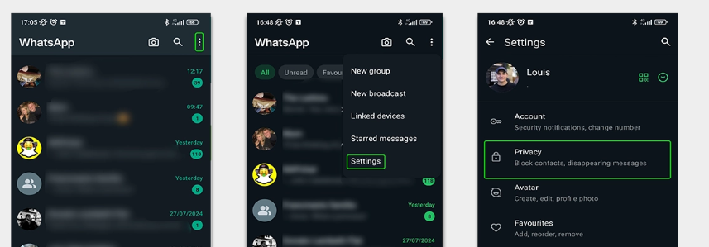
Parental Controls - WhatsApp
This guide goes into clear detail on how to support your child with their settings.
Consider making it so that your child has to be invited to join a group and disable automatic downloads so that if your child is sent an inappropriate image this doesn’t automatically save to their device.
Click on the three dots, then on settings and then privacy.

Slide 12
Acronyms to be aware of in group chats or gaming chats:
  POS – Parent Over Shoulder
  PIR – Parent In Room
  KMS – Kill Myself (often used in distressing conversations)
  KYS – Kill Yourself (can be used in cyberbullying)
  ASL – Age, Sex, Location (used by strangers to get personal info)
  GNOC – Get Naked On Camera
  LMIRL – Let’s Meet In Real Life
  FWB – Friends With Benefits
  NFSW – Not Safe For Work (can indicate explicit content)
  IDK – I Don’t Know
Do monitor language being used and have open discussions with your child.

Slide 13
Resources & Support
Resource for primary teachers: Primary online safety for teachers May be useful for you and your child to look at together.
The Online Safety Act came in in 2023 and aims to provide more protection. You can see this act here: Online Safety Act: explainer - GOV.UK
https://www.nspcc.org.uk/keeping-children-safe/online-safety/
https://www.ceop.police.uk/Safety-Centre/
Notes:
The Act will give providers new duties to implement systems and processes to reduce risks their services are used for illegal activity, and to take down illegal content when it does appear.
The strongest protections in the Act have been designed for children. Platforms will be required to prevent children from accessing harmful and age-inappropriate content and provide parents and children with clear and accessible ways to report problems online when they do arise.
Coming soon- More safety checks on a child’s age including facial recognition rather than just text in boxes.

Slide 14
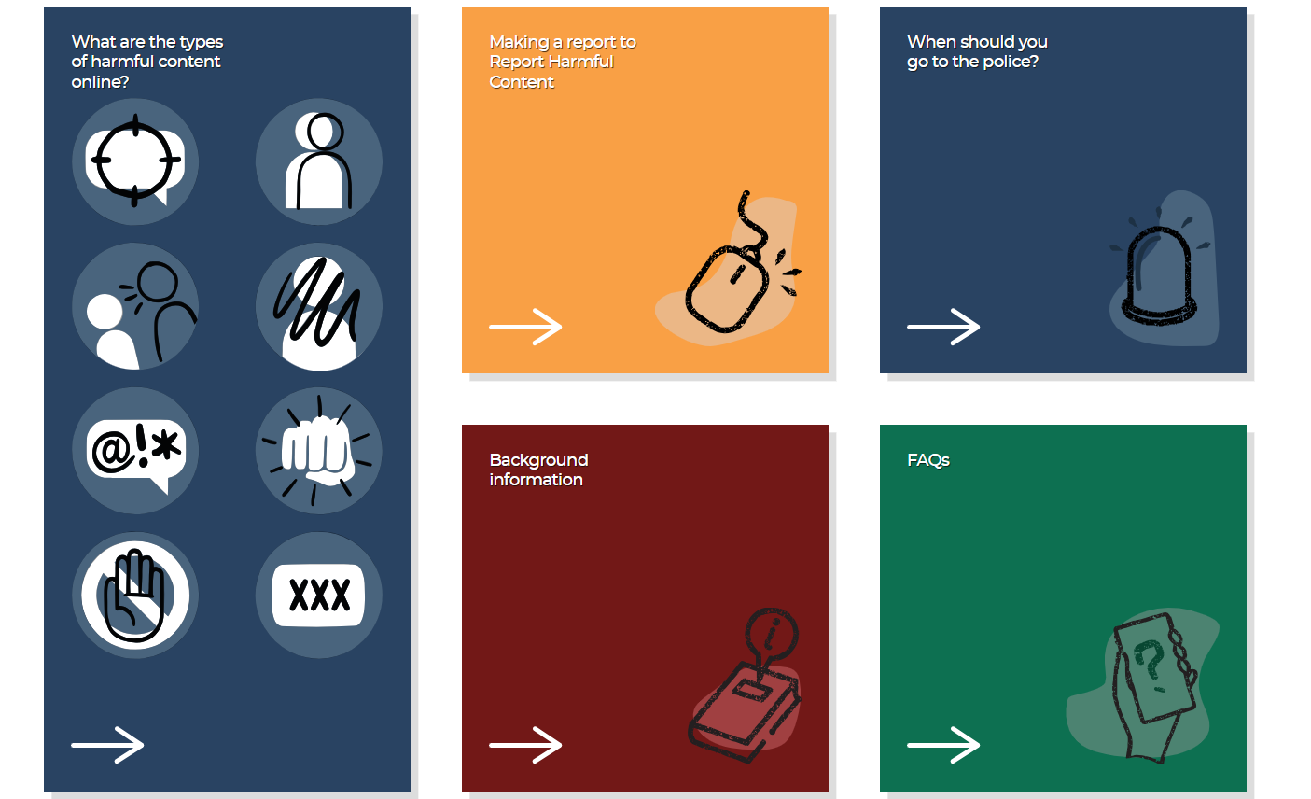
How to report incidents outside of school- www.reportharmfulcontent.com
If an incident happens outside the school day this becomes a matter for the police, schools cannot follow up all incidents of cyber-bullying etc. even if all of the children involved are pupils in the school.
Notes:
Secondary school policy – if it happened outside school, we will give you information on what to do but not follow it anything that is not directly a school matter. We would always recommend that you go to the police.

Slide 15

What you can report
Threats
Impersonation
Bullying & Harassment
Self-harm
Online Abuse
Violent Content
Unwanted Sexual Advances
Pornographic Content

Slide 16
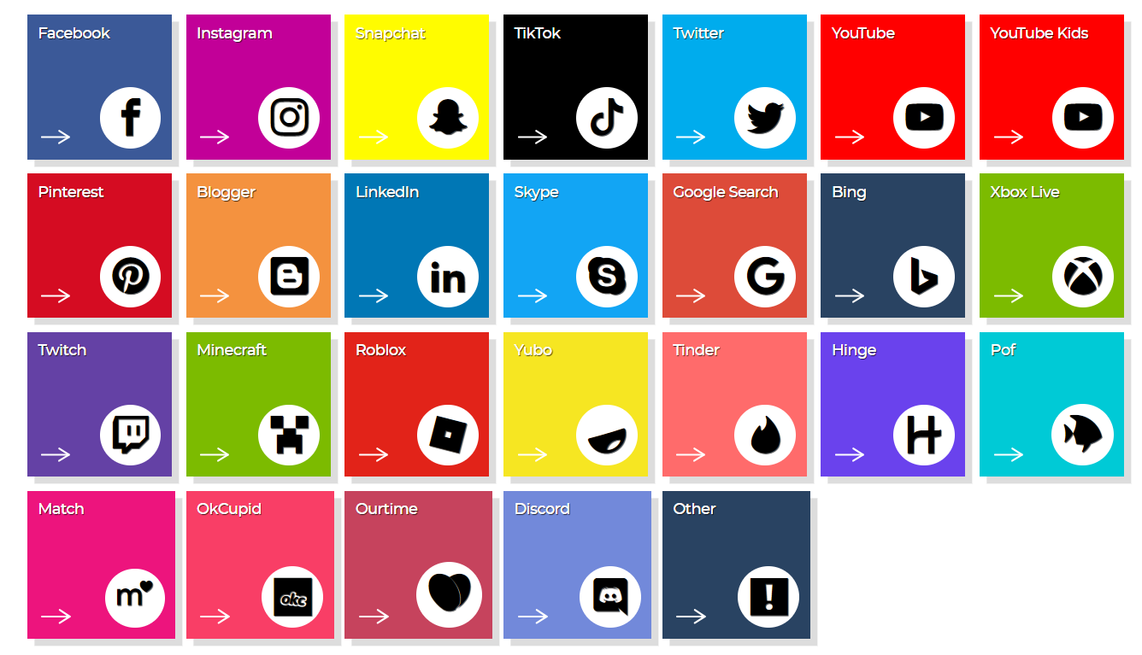
What platforms they work with
Please note WhatsApp doesn’t work with this system.

Slide 17
When is the best time to get a smartphone?
This is a decision you can discuss as a family with your child, some helpful resources are below on why delaying may be beneficial:
Video from Institute of Child Psychology
They recommend delaying a smartphone until the age of 14 and social media until 16.
They say that this will aid brain development, self-regulation, mental health and wellbeing, social and emotional skills, sleep, cyber security and enjoyment of real-world activities
Watch Swiped: The School That Banned Smartphones | Stream free on Channel 4
This programme showed that within 4 hours children were exposed to harmful content online even with the correct age setting of 13.

Slide 18

Alternatives to a smart phone
https://smartphonefreechildhood.co.uk/alternatives
Social media accounts can all be signed up to with an email address and do not need to be on a smartphone, so do monitor and check privacy settings on your child’s other devices too.

Slide 19
Any Questions?
For further support Mr Pastor is the e-safety lead at Barton, supported by Mrs Martin.
Thank you for listening!

Slide 20
Additional Content…
These slides are taken from internet matters and I will not discuss them but they may be helpful to look over and provide useful reference:
https://www.internetmatters.org/

Slide 21
Risk is not harm
While risk-taking can lead to harm, it more often results in children discovering new passions and abilities.
Positive actions can limit risks from becoming harmful. Here are 5 tips:
Understand the risks
Communicate regularly
Keep risks in proportion
Agree on helpful mediation strategies
Develop coping strategies to foster resilience
Notes:
Although we mentioned some harms that could come with the risks we just talked about, it’s really important to remember that risk does not always equal harm. A child riding their bike without training wheels is a risk, but it often leads to more confidence and independence. This is true for a lot of online activities as well.
These positive actions can limit risks from becoming harmful:
Understand the risks and the likelihood of them leading to harm;
Communicate regularly with normal conversations about your child’s digital life – in the same way you might ask about their day at school;
Keep risks in proportion. Although you might worry about online harms, for example, taking away their device is often more harmful than good as you also take away the benefits they experience.
Agree on helpful mediation strategies with your child for if a risk starts to feel harmful – such as talking to you or using block and reporting features.
Develop coping strategies to foster resilience. Again, this could include blocking or reporting content or users, or it could be taking a screen break or limiting their time online.

Slide 22
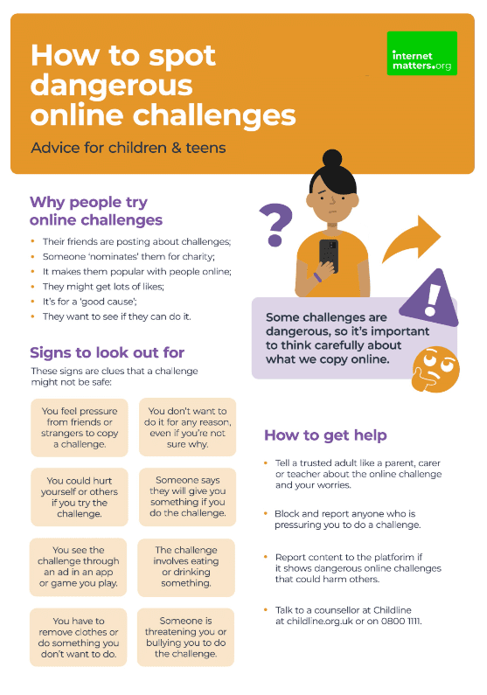
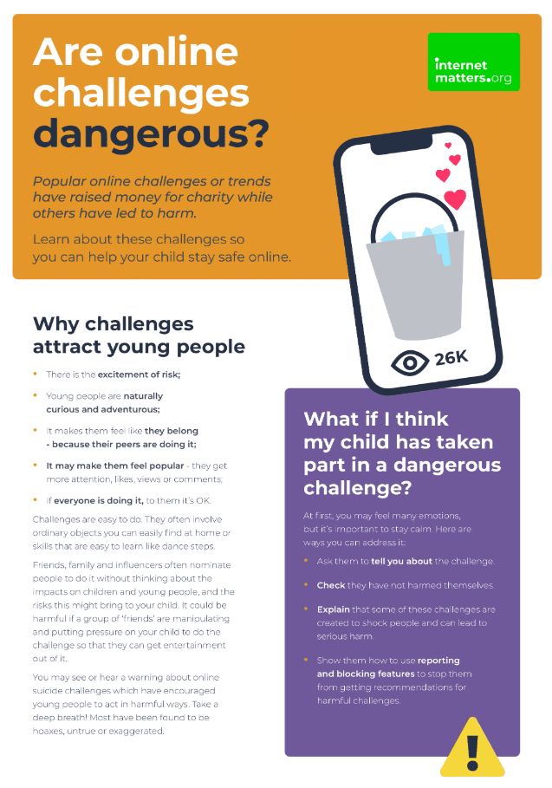

Dangerous online challenges
Viral online trends attract many children and teens
Most are harmless, but some can be dangerous
1 in 5 children say they’ve come across content which promotes dangerous stunts or challenges
It’s important to talk with your child so they understand the dangers and can avoid potential harm.
Notes:
You might have seen some online challenges and trends recently, or you might remember trends like planking and flash mob dances that were popular years ago.
These types of challenges attract many children but while most of them are harmless, some can be dangerous.
In Internet Matters’ survey, around 1 in 5 children aged 9-17 said they had come across content that promoted dangerous stunts or challenges. It’s important to remember that this is self-reported, and some children might see this content without realising it’s dangerous.
You’ll see a lot of these trends on social media, so it’s really important that you talk to your child about dangerous challenges. You can find more guidance about how to safely talk about this issue at InternetMatters.org or by scanning the QR code on screen.

Slide 23



Online bullying (cyberbullying)
Online bullying is more difficult to escape than ‘traditional’ bullying
It can happen between friends or strangers
It can happen in video games, on social media, in messaging apps, etc.
About 1 in 10 children say they have experienced online bullying. This increases for children with SEN needs or similar vulnerabilities.
Set parental controls, talk about healthy behaviour and show your child how to block and report content.
Cyberbullying conversation guide
Notes:
A common issue that a lot of parents worry about is cyberbullying (or bullying that happens online). The biggest thing to remember about it is that it’s so much more difficult to escape than ‘traditional’ bullying. And, actually, a lot of offline bullying then continues online.
Cyberbullying can happen between friends or strangers and can happen on social media, in video games, through messaging apps, in comment sections, and basically anywhere where people interact with others.
About 1 in 10 children say they have experienced online bullying, and this number increases with children who have SEN needs or similar vulnerabilities.
Talking about cyberbullying, including what it looks like and how to take action against it, is important. If you scan the QR code, you can access Internet Matters’ conversation guide.
You can also set parental controls to limit contact, customise disallowed words and show your child how to report or block bullies.

Slide 24

Inappropriate content
27% of children see pornography by age 11
Around 1 in 10 children report seeing pornographic or violent content online. This increases with age.
Children with vulnerabilities are more likely to come across these things – especially violent content.
Parental controls can help limit access to certain websites, content and more. It’s also important for your child to report any inappropriate content they accidentally come across.
Notes:
The Children’s Commissioner for England ran a survey which found that over a quarter of children had seen porn by age 11; 10% had seen it by age 9. And the average age children first see pornography is 13. This could be through curiosity or stumbling across the content by accident through ads on other websites. Their friends might also share this content with them.
An Internet Matters survey of children aged 9-17 found that 1 in 10 reported seeing pornography or violent content online. As children grow and if a child has SEND needs – including autism, sensory impairments, communication needs, ADHD and even dyslexia or physical disabilities – they are more likely to come across this content.
Unfortunately, if children see a lot of this content, they can become desensitised, which means it’s harder for them to recognise when something is harmful. So, setting parental controls on broadband and mobile, talking to them about why some content is not appropriate and showing them how to use reporting tools is really important. Especially if inappropriate content makes its way through a filter that should have stopped it; this helps the platform strengthen these filters and protect users who do not want to see such content.

Slide 25

Spending too much time online
41% of children believe they spend too much time online
Of these children, most reported it causing them some distress, upset or harm
Not all screen time is negative, but if your child’s wellbeing is negatively impacted, they need your support.
Most games and apps have screen time controls to manage this, but you should also help them find other activities to make their time online positive.
Guide to
balancing screen time
Notes:
The last issue we’ll look at today is spending too much time online.
Internet Matters asked 9-17-year-olds to identify issues they’ve experienced online. Of the 25 options, 41% said they spent too much time online – and this was the most highly reported issue of all listed.
As much as parents often think their children spend too much time online, this research shows that children recognise this as well. They just might not yet have the ability to regulate themselves to have a more balanced digital experience, which is why it’s important to set parental controls and screen time limits in their apps and games.
It’s also important to help them use their devices for a range of purposes such as learning and creating rather than just consuming content.
You can scan the QR code for Internet Matters’ guide to balancing screen time if you need more support.

